Slide 1
Aligning infrastructure delivery with community value
Strengthening business certainty and regional outcomes in Renewable Energy Zones
Presented by: Gregory Ley (Lecroma)
6th Annual REZ Conference | May 2026

Slide 2
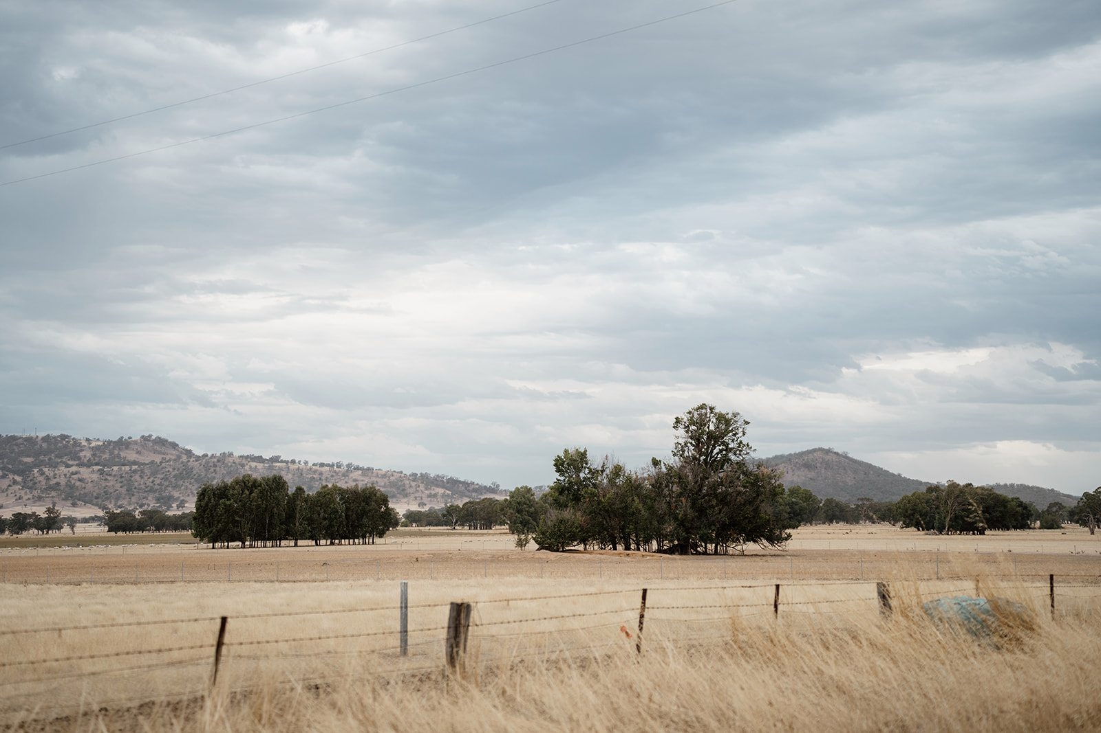
From policy to construction delivery reality
The risk profile has changed. ‘Planning and coordination’ are ideas, not the reality. Expect higher costs….
Global frame
Demand side
If delivery planning and FID continues to stall in REZ’s, especially NSW regions, the cost shows up as price volatility, missed financial close (FID) windows, construction start delays, and capital looking for friendlier jurisdictions (… regions, or other countries).
Comparable shifts are under way globally. UK NESO is moving to a Strategic Spatial Energy Plan. The US has tied funding to "energy community" provisions in the IRA. The EU has passed the Net-Zero Industry Act. China operates an aggressive highly planned and coordinated approach, outpacing all global efforts combined.

Slide 3
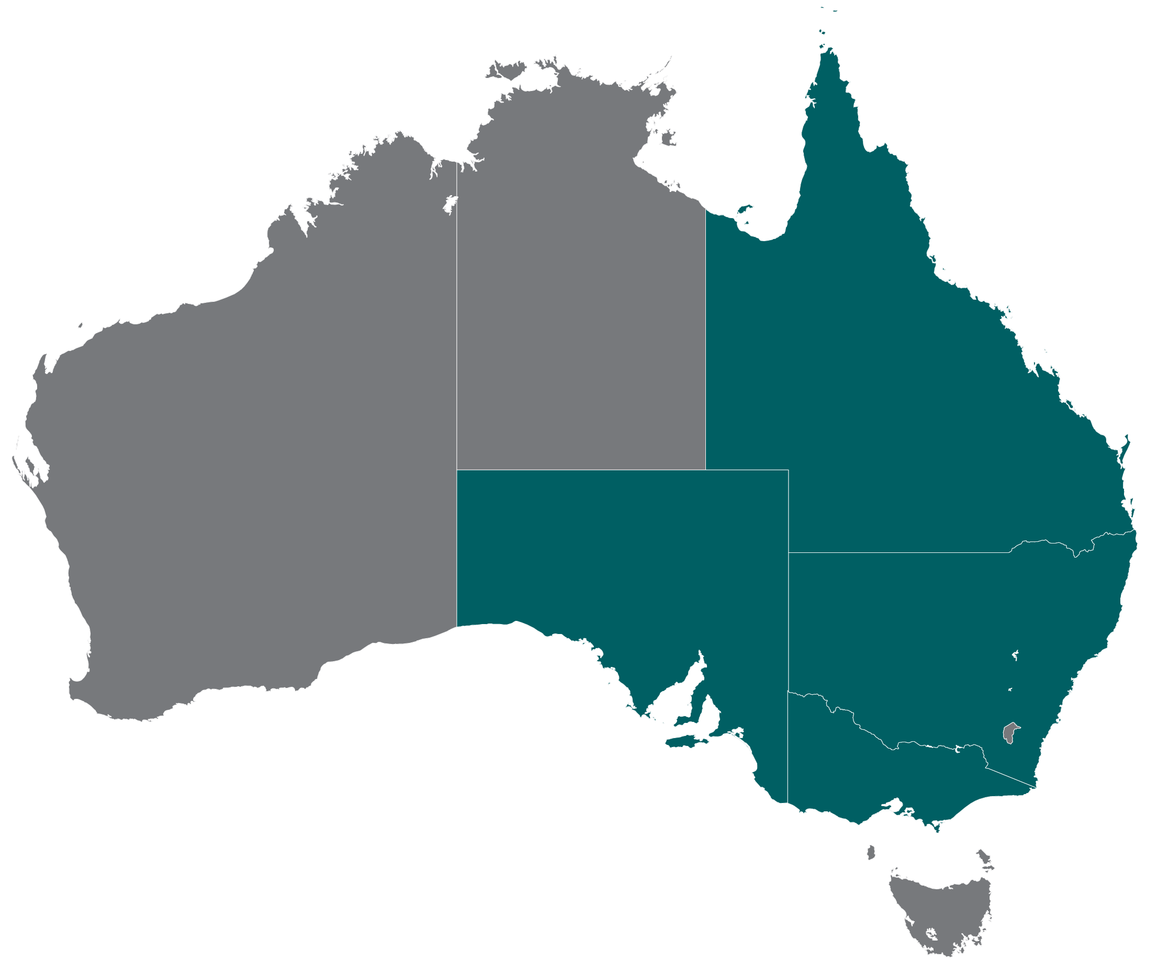

The national picture
6
offshore declared
DCCEEW
Gippsland, Hunter, Southern Ocean, Illawarra, Bass, Bunbury
~21 REZ-equivalents
tracked nationally
across five jurisdictions.
3
regional hubs
Powerlink QLD
QLD
Southern Downs, Banana/
Capricornia, Northern QLD
SA
5
declared
NSW
EnergyCo NSW
1
CWO, NE, SW, HCC, Illawarra
proposed
VIC
ElectraNet
5
proposed
Mid-North SA corridor
VicGrid
Murray River, Wimmera Mallee, Central North, Western VIC, Gippsland
Sourced and confidence-scored. But still missing the point…

Slide 4
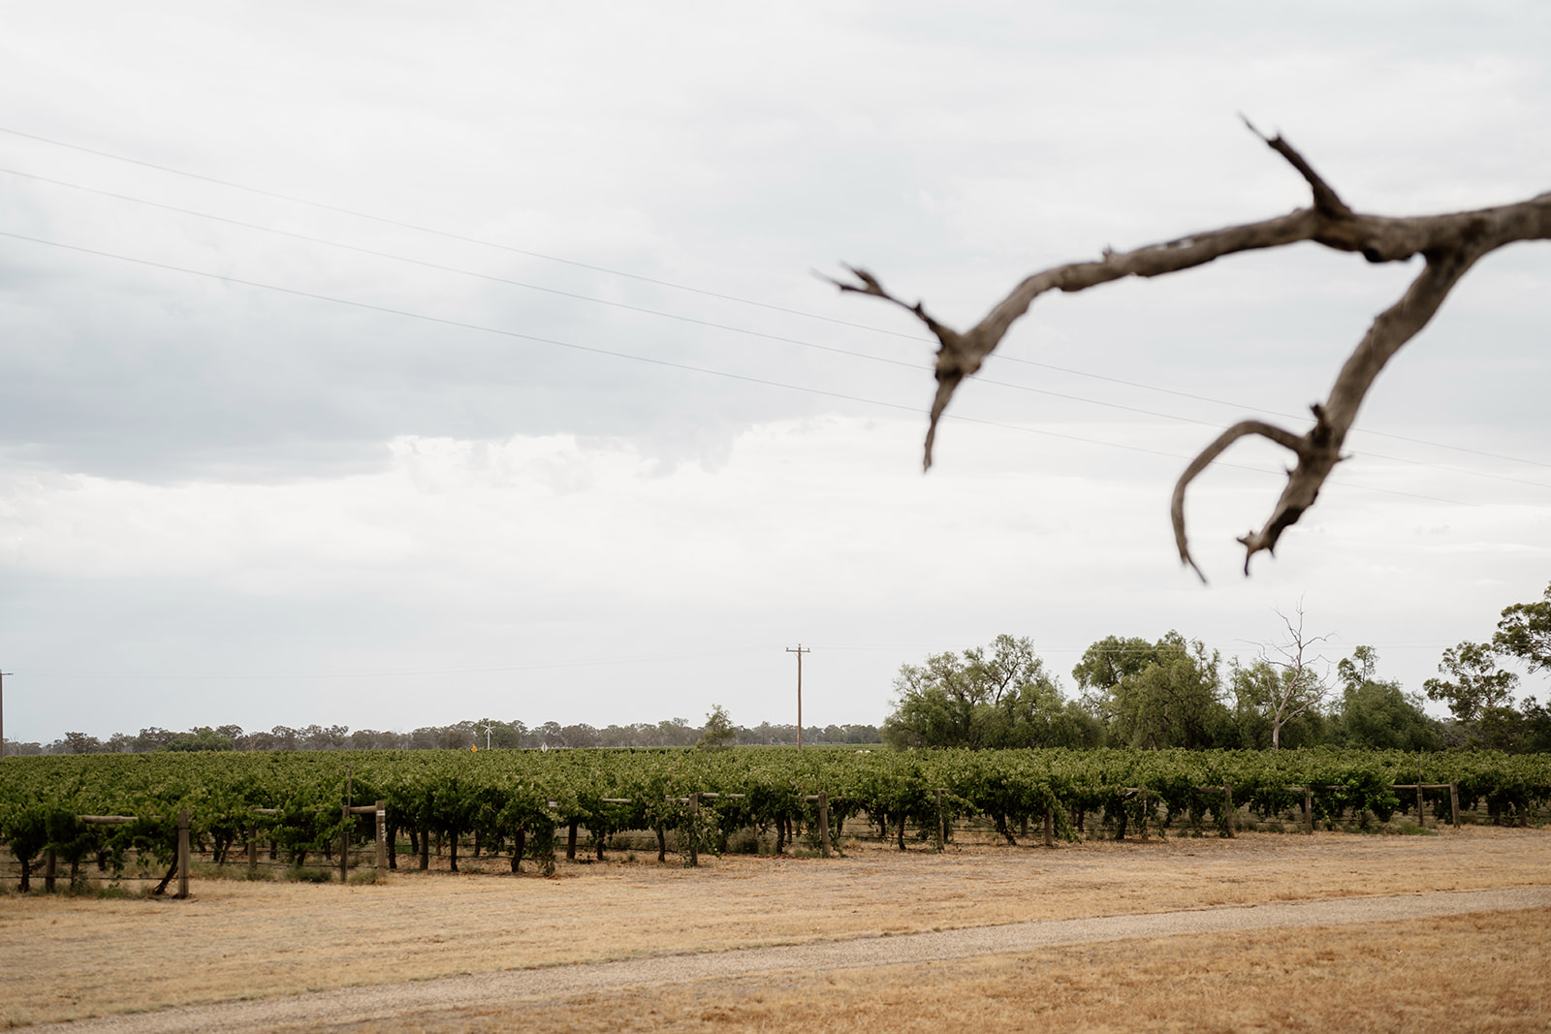
The cumulative test
Material pressure, with sourced specifics
Pressure on Australia's construction labour, supply chain and skills base is extensive and expanding.
REZ-equivalents
NSW data centres
21
Nationally tracked across NSW, VIC, QLD, SA and Commonwealth offshore.
>$51.9b
15 projects endorsed by NSW IDA. 6,500 peak workforce. Same labour basin as HCC REZ.
Source: Lecroma REZ Project Watch
Source: InsuraCatastrophe Resilience Report 2024-25​
Source: NSW Government, March 2026
Inland Rail NSW (… chopped at Parkes)
Defence NSW
$14b+
>$6b
~2,400 peak workforce to 2030. Through Parkes, Narromine, Narrabri, Albury. Would initially overlap CWO and SW REZ, now this has changed – more pressure on roads / trucks.
AUKUS, Garden Island Stage 2, Holsworthy, RAAF Williamtown, RRJV (Wagga-Abury-Wodonga), Benella/Mulwala. Combined ~5,500+ peak for 3+ years to 2030.
Source: ARTC.
Source: Department of Defence.

Slide 5
What is hitting the region at once
Cumulative pressure on towns, services, roads, landholders, councils and local economies
Transmission
Generation
Storage
High-voltage lines, easements, towers
Solar, wind, project clusters at large scale
BESS sites, hydro, ancillary services
Road upgrades
Workforce accommodation
Heavy vehicle movements
Heavy haul corridors, intersections, bridges
Camps, rentals, regional housing pressure
Hundreds of thousands of truck movements
Water
Waste
Social pressure
Construction, dust, potable, wastewater
Solid, liquid, decommissioning, packaging
Health, childcare, services, community trust
Plus the wider pipeline:
Data centres
Defence projects
Other non-SSD
development
Data centre concurrency: IEA Electricity 2026: global data centre electricity use is on track to double by 2030, with “correlated peaks that can overwhelm local networks”.
Source: IEA, Electricity 2026

Slide 6
Five tensions under pressure
What is breaking under cumulative load
Speed
vs
Consent
The transition needs pace. Rushing regional engagement creates delay later.
Project approvals
vs
REZ-wide impacts
The planning system assesses projects separately but communities experience them together.
Temporary workforce
vs
Permanent housing
Worker accommodation must not cannibalise local housing. It can leave a useful legacy.
Competition
vs
Coordination
Proponents compete for access, labour and approvals. They need to cooperate on regional capacity.
Benefit money
vs
Public trust
Funding alone will not repair trust if decisions feel already made.

Slide 7
Shared Value Masterplan concept: solve foundational project delivery problems, commit to actions
A REZ-scale coordination framework, reimagining REZs as ‘special economic development’ zones. The goal: solve foundational project delivery problems now, scale for future projects in the pipeline.
01
02
03
04
05
06
07
Shared
evidence base
Cumulative impact map
Regional priorities
Precinct-based solutions
Benefit-sharing architecture
Governance and decision rights
Staged
delivery plan
Single source of truth across studies
Open data and transparent methods
Updated as projects progress
Stack impacts across projects
Visualise land, traffic, amenity
Identify hotspots early
Anchor to community-set goals
Align with state and council plans
Prioritise where need is greatest
Tailor responses to each locality
Co-design with traditional owners
Bundle infrastructure and amenity
Coordinated, durable benefit streams
Indigenous and community funds
Transparent allocation rules
Defined roles across partners
Independent oversight
Dispute resolution pathways
Sequenced milestones and triggers
Investment-ready packages
Monitoring and review cadence

Slide 8
Precinct-based, not project-based: less cost, more scale
‘Goldilocks zones’ between project clusters: known, fundable, scalable
Shared precinct services across project clusters
01
02
03
04
05
Workforce
and training
Lay-down, storage and supply
Medical and social services
Transport and logistics: Port via rail to regions
Intelligence and supplier concierge
Shared accommodation villages
Local trades and TAFE pipeline
Reused across delivery stages
Common hardstand and staging areas
Bulk procurement of materials
Fewer truck trips into region
Scaled to peak workforce
Benefits host communities
Lasting community legacy and underwriting of services
Shared road and rail access pathways
Coordinated freight scheduling in / out
Reduces local network impact, costs and impact on truck availability
Cross-project data sharing
Common dashboards and reporting
Pre-qualified and onboarded suppliers via ICN

Slide 9
Who delivers the precinct services
Stakeholder groups mapped to the first five shared precinct services
Stakeholder group | 01 - Workforce & training | 02 - Lay-down, storage & supply | 03 - Medical & social services | 04 - Transport & logistics | 05 - Intelligence & concierge
Proponents | ● Co-fund accommodation | ● Anchor demand, co-fund | ○ Co-fund with other proponents | ● Movement plans, freight | ● Data feeds, share intel, co-fund the service
Federal, State & local government | ○ Land, planning, services | ○ Land, planning approvals | ● Lead delivery and funding | ● Roads, rail, network plans | ○ Convene, host platforms
Traditional Owners | ○ Cultural inputs, employment | ○ Country-based siting consent | ○ Health, language, culture | ○ Routes, cultural heritage | ○ Consent on data use
Local industry & ICN | ○ Trade subcontracts, EOIs | ● Supplier identification, procurement, job-readiness |  |  | ● Pre-qualified supplier list
TAFE & training providers | ● Curriculum, apprentices | ○ real-word training space on-the-job | ○ Allied health training | ○ Driver, logistics tickets | ○ Data and digital skills
Host communities | ○ Workforce, social licence | ○ Land use, amenity input | ○ Co-beneficiaries, users | ○ Local routes, impacts | ○ Public dashboard users
● Drives delivery ○ Supports/contributes

Slide 10
The lost opportunity to reduce project delivery cost and uplift regional development if we don’t give it a crack
What precincts propose to unlock beyond a bed for a worker and some consolidated logistics
1
The 1% game: a pragmatic way of collaborating that is scalable and reduces $ loss
2
Micro-manufacturing and R&D incentives: breakdown inputs, localise where possible
3
Circular and sustainable construction methods
4
Port-rail-to-region efficiency for all international sources inputs (and far region)
5
Repurposable precincts and model for follow-on projects / regional development
6
Data centre adjacency and co-located demand increases regional loads
Public dashboard

Slide 11
The real game: re-industrialisation
Smarter on-shore investment into industrial capability development in REZs
At a policy level, Australia is messaging a path to re-industrialising our economy. But the experience at the private sector (proponent and OEM/contractor) doesn’t always feel that way. Risk is primarily passed on to private capital, which is then passed on to increased cost of living. It doesn’t have to be this way.
Australia
European Union
United States
Future Made in Australia
Net-Zero Industry Act
Inflation Reduction Act
$22.7b federal allocation
Strategic net-zero projects
“Energy community” bonus credita

Slide 12
Practical step: a live dashboard
Live pilot tool: https://rez-project-watch.pages.dev/
/pipeline | 21 zones, project counts, status
/competing-pressures | Inland Rail, data centres, Defence overlay
/business-certainty | Concurrency risk index per region
/accord | Delivery table commitments register
/changes | What has changed since last verified
/framework | 7 parts of the Shared Value Masterplan
/precincts | 5 shared services, mapped by zone
/stakeholders | Who drives, who supports, per service
Scan the QR code
to open the live test dashboard

Slide 13
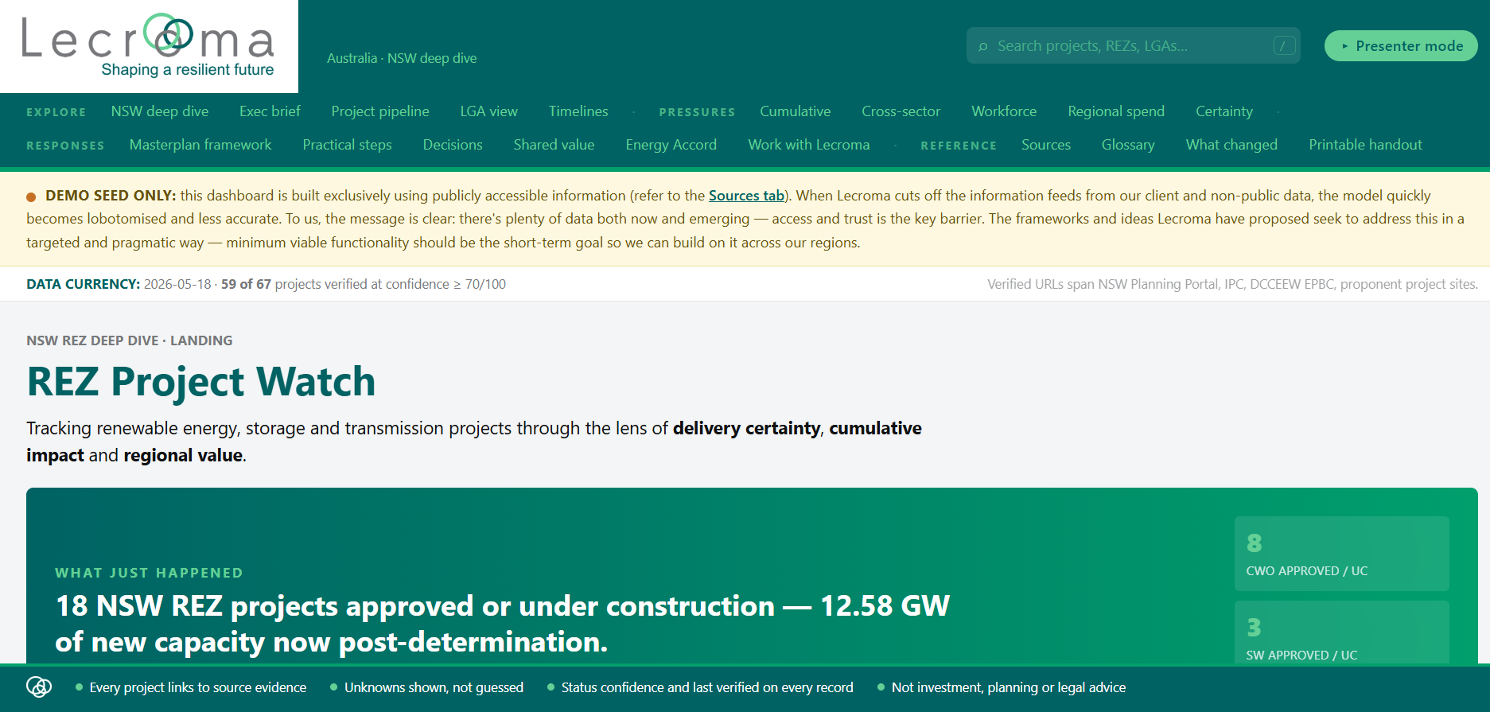

Slide 14
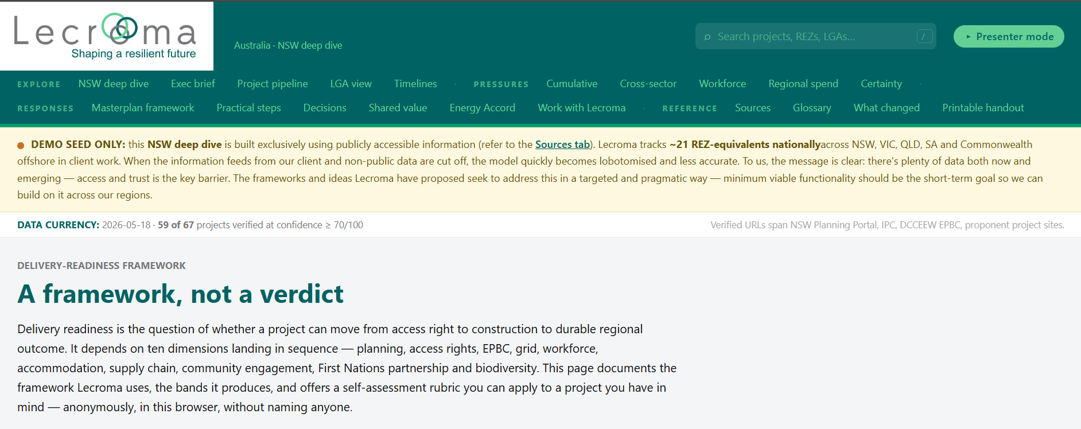

Slide 15
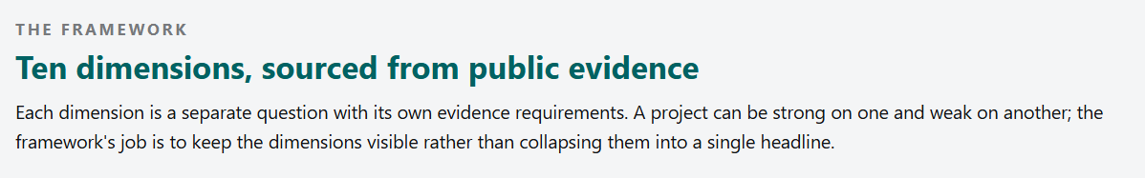
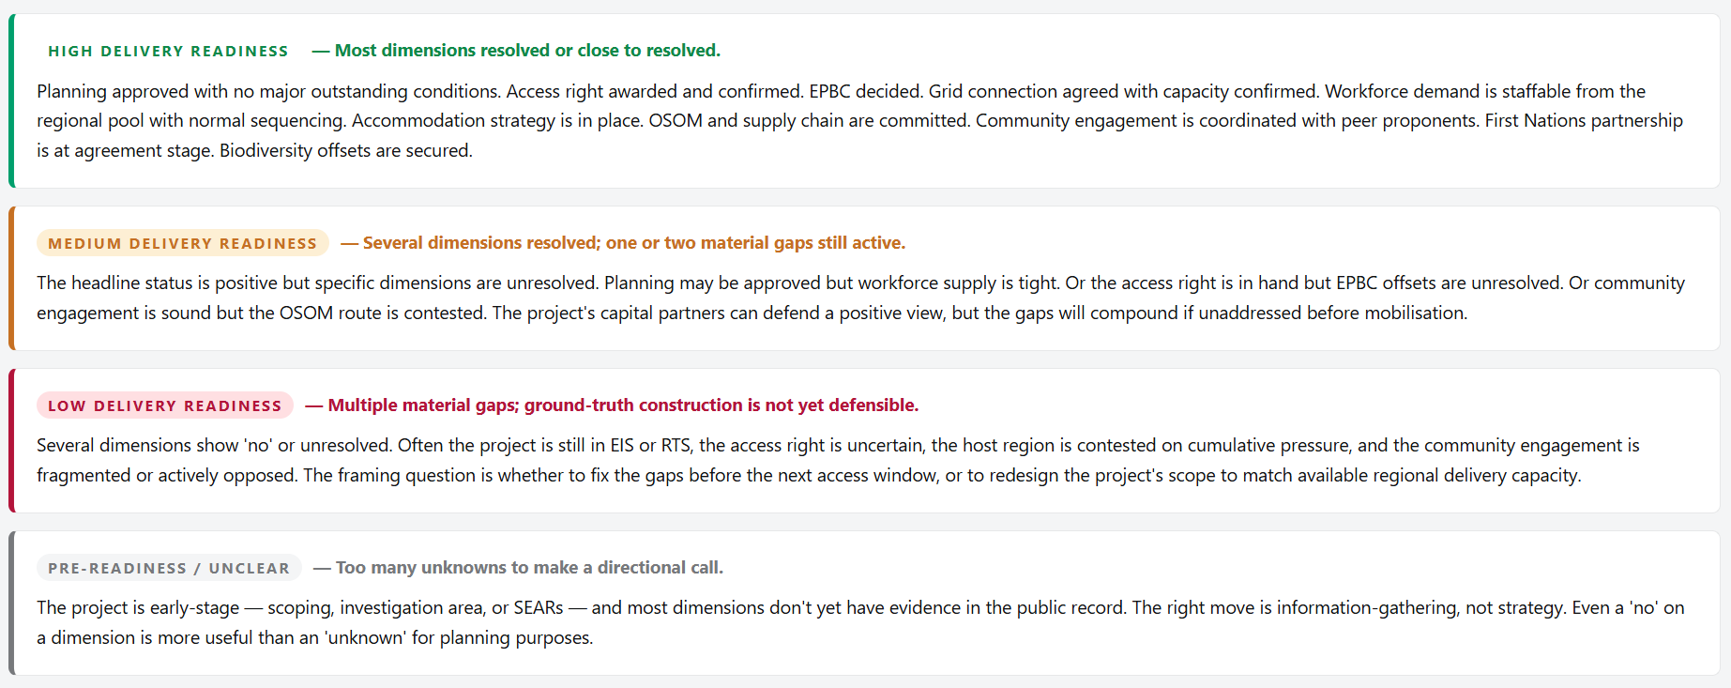

Slide 16
The next phase will not be won by the best individual project or benefit scheme. It will be won by regions and proponents that coordinate delivery approaches, impact management, investment and trust at scale.
Get that right, and REZs build the next layer of regional capability and development.

Slide 17


Thank you. Come have a yarn
Scan the QR code
to open the live test dashboard
Gregory Ley
greg@lecroma.com
linkedin.com/gregley

